Slide 1
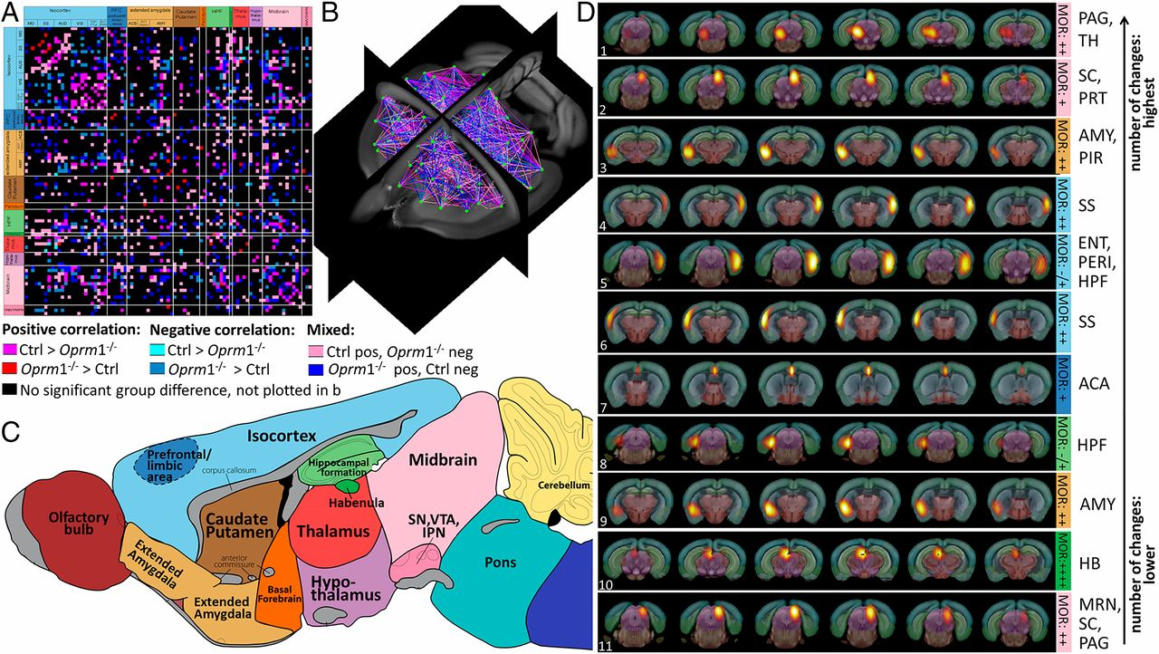
Quantitative mapping of functional network alterations in Oprm1−/− mice reveals a MOR-dependent activity signature in live animals.
Anna E. Mechling et al. PNAS 2016;113:11603-11608
©2016 by National Academy of Sciences
Notes:
Quantitative mapping of functional network alterations in Oprm1^{−/−} mice reveals a MOR-dependent activity signature in live animals. (A–C) Direct intergroup (Ctrl vs. Oprm1^{−/−}) statistical comparison of connectivity matrices (P < 0.05, FDR-corrected) is shown as a 2D-matrix (A) or a 3D view (B). Functional nodes were grouped and color-coded as assigned in the sagittal brain view from C. The Oprm1 genetic inactivation induced widespread modifications of internode connectivity. (D) Nodes with the highest number of statistically significant connectivity changes are ranked. Their functional pattern is overlaid on the Allen Brain Atlas, for precise anatomical identification. The top-10 nodes correspond to brain areas associated with pain/aversion processing or double players involved in both pain and reward (PAG/TH, SC/PRT, bilateral AMY, bilateral SS, and MRN/SC/PAG, ACA, HPF, HB). Information on MOR density (10) is included [from low “−/+” barely detectable in the entorhinal area (ENT)/perihinal area (PERI) cortex and HPF to “++++” highest expression in HB].

